Slide 1
Health of North Carolinians Alternative Database Products
By: Josh Bleeker, Mena Wadie, Bilal Naeem, Alex Kahn
Notes:
Hello, my name is Joshua Bleeker and our presentation is about the Health of North Carolinians Alternative Database Products.

Slide 2

Introduction
The goal is to improve health of North Carolinians
The department will deploy care plans
We had to compare and contrast databases
We compared: Mysql, Oracle, and IBM
Notes:
The goal of the project was for my team and I to work to improve the health of North Carolinians through an integrated and well-coordinated system of care that addresses both medical and nonmedical drivers of health.
The department will integrate care plans with a benefits package that spans both physical and behavioral health services, as well as long-term services and supports (LTSS) and pharmacy benefits.
My team and I are tasked with with comparing and contrasting popular database products to find which system will better serve these new data requirements.
The three database products that will be compared are: Mysql, Oracle Database, and IBM.

Slide 3
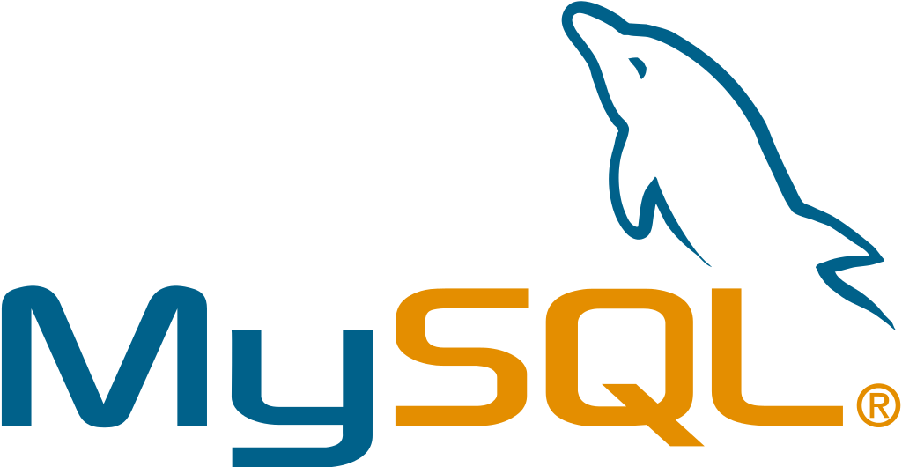
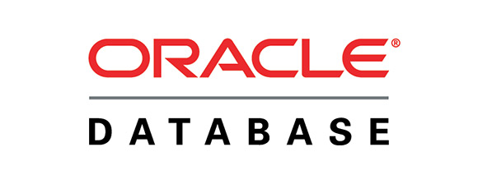

Products
MySQL
Oracle Database
IBM Db2
Notes:
Mysql:
MySQL is an open source relational database management system (RDBMS) with a client-server model.
RDBMS is a software or service used to create and manage databases based on a relational model. In fact all 3 of these databases are relational
Oracle Database:
Oracle Database is a multi-model database management system
It is a database commonly used for running online transaction processing, data warehousing and mixed database workloads.
IBM:
IBM Db2 is a family of data management products, including the Db2 relational database. The products feature AI-powered capabilities to help you modernize the management of both structured and unstructured data across on-premises and multicloud environments.

Slide 4
MySQL
Used for both small and large applications.
It is a relational database (RDBMS)
MySQL is fast, reliable, and flexible
Fully Multithreaded
Works on many different platforms
Notes:
MySQL is a database system used for developing web-based software applications.
MySQL used for both small and large applications.
MySQL is a relational database management system (RDBMS).
MySQL is fast, reliable, and flexible and easy to use.
MySQL is free to download and use.
MySQL Written in C, C++.
Main Features of MySQL
MySQL server design is multi-layered with independent modules.
MySQL is fully multithreaded by using kernel threads. It can handle multiple CPUs if they are available. Which it means it is scalable and can take advantage of more powerful hardware
MySQL provides transactional and non-transactional storage engines.
MySQL has a high-speed thread-based memory allocation system.
MySQL supports in-memory heap table.
MySQL Handles large databases.
MySQL Server works in client/server or embedded systems.
MySQL Works on many different platforms.
Who Uses MySQL
Some of the most famous websites like Facebook, Wikipedia, Google (not for search), YouTube, Flickr.
Content Management Systems (CMS) like WordPress, Drupal, Joomla, phpBB etc.
A large number of web developers worldwide are using MySQL to develop web applications.

Slide 5
Oracle Database
Quickly store and retrieve data
It is cross-platform
ACID-Compliant
Is a relational database
Notes:
Oracle Database features
Oracle Database allows you to quickly and safely store and retrieve data. Here are the integration benefits of the Oracle Database:
Oracle Database is cross-platform. It can run on various hardware across operating systems including Windows Server, Unix, and various distributions of GNU/Linux.
Oracle Database has its networking stack that allows application from a different platform to communicate with the Oracle Database smoothly. For example, applications running on Windows can connect to the Oracle Database running on Unix.
ACID-compliant – Oracle is ACID-compliant Database that helps maintain data integrity and reliability.
Commitment to open technologies – Oracle is one of the first Database that supported GNU/Linux in the late 1990s before GNU/Linux become a commerce product. It has been supporting this open platform since then.
Benefits of Oracle Database:
Lets users consolidate multiple databases into a single database, that shrinks operations and licensing costs.
The single database approach offers numerous advantages.
The database has a high resistance to data crashes.
The application has a quick online backup and recovery system.
The database provides all the advantages of a secure hybrid cloud environment. It cuts IT costs, adds flexibility, and offers more data deployment options than competitors.
It also verifies the identity of a user trying to access an object.
Includes Flashback technology:
Flashback allows you to recover data incorrectly deleted or lost. That essentially removes human error and decreases database recovery time.

Slide 6
IMB Db2
RBDMS
Developed for Resilience/Efficiency
AI-powered capabilities
Makes it easier to access data
Notes:
relational database management system
developed for resilience, efficiency, and pricing
make it easier and simple for user to access data
The main goal of IBM Db2 is for business to see the importance and value of AI
Main features:
Mid-size to large companies can use it
Industry-leading performance: fast data retrieval which includes large amount of disk space
Advanced protection
Like MySQL, IBM database is available 24/7 with auto resynchronization
Works with multiple data types and languages: NoSQL, Ruby, Python, Perl and more for building robust apps
Automatic setup, optimization, diagnostics and management of the database environment
multi cloud and hybrid environments to reduce storage costs
Who Use IBM Db2?
Many companies use IBM Db2 which includes: Audi, Swiss Re, and Nike.

Slide 7

Comparison
All 3 are relational databases
MySQL is open source
Db2 is known to be very scalable
Oracle has wide array of tools
Notes:
Oracle vs IBM Db2
Oracle supports Mac OS X while IBM does not support
Oracle Database supports Eiffel, Erlang, Groovy, Haskell, JavaScript but IBM does not support it
IBM provides Db2 when you support iSeries while you have to pay for it separately when purchasing Oracle
Both were released around the same time which was early 1980s
Both of them support implemented in C and C++ and support similar server operating systems (AIX, HP-UX, Linux, Solaris, Windows, z/OS)
Db2 is well known for reliability and scalability, while Oracle Database is more known for its wide range of applications, tools, skills, and partners available
Both are very stable databases, with large amounts of documentation and good support
Oracle vs MySQL
MySQL provides a GPL software license, while Oracle doesn’t
MySQL is compatible with Symbian, BSD, and AmigaOS
Oracle supports distributed databases while MySQL doesn’t
MySQL is free while Oracle requires a licensing agreement
Oracle is compatible with Linux, UNIX, Windows, Mac OS X and z/OS. MySQL is compatible with all of those plus Symbian, BSD, and AmigaOS.
Oracle is better for enterprise deployments, while MySQL is suited for small to medium scale.
MySQL supports full-text and hash indexing only. Oracle uses more indexes including Bitmap, function-based, Partitioned, and so forth.

Slide 8

Opinion/Takeaway
Each database has own strengths
We will be working with large datasets
Cost is an important factor
Oracle is more robust for larger data sets
Notes:
Each database has advantages and disadvantages making the right database a case by case scenario
The database needed for the healthcare system is one that can handle large quantities of data, have quick access to the data in the database, and the data of the database must be secure and reliable
Cost plays a role in which database will be implemented, because this is a state funded project we need to balance the cost of the database, and the performance it provides
MySQL is designed for new users to get familiar with and design limited databases, Oracle Database is a more professional and robust database for larger projects, and IBM Db2 is designed for databases involving artificial intelligence

Slide 9

Conclusion
Oracle is the best choice for us
Oracle is well worth the money
Oracle is perfect for our large database
Oracle Flashback is a major benefit
Notes:
For the state of North Carolina to provide a well designed system that addresses all areas surrounding keeping citizens healthy, their best choice will be Oracle Database
Oracle gets a bad rap for being over priced, however when you look at the structure of their database it is a worthy investment
Oracle Database satisfies all the needs of the state by providing a large database, in which data can be easily and quickly accessed
The Flashback technology that Oracle databases have is a key selling point in our case because if there is a loss of information at any point in the database users would not be able to access vital information about their health

Slide 10
Bibliography
Database concepts. Introduction to the Oracle Database. (2005, October 10). Retrieved April 26, 2022, from https://docs.oracle.com/cd/B19306_01/server.102/b14220/intro.htm
DB2 features - javatpoint. www.javatpoint.com. (n.d.). Retrieved April 26, 2022, from https://www.javatpoint.com/db2-features#:~:text=DB2%20Server%20Features&amp;text=platform%20%2D%20linux%2C%20unix%2C%20and,xml%20backup%20compression%20homogeneous%20federations
DB2 database - Belgium/Luxembourg - IBM. (n.d.). Retrieved April 26, 2022, from https://www.ibm.com/be-en/products/db2-database
IBM DB2 vs. Oracle Database Comparison. DNSstuff. (2021, May 17). Retrieved April 26, 2022, from https://www.dnsstuff.com/db2-vs-oracle
Dearmer, A. (2020, October 8). Oracle vs. mysql: Compare syntax, features &amp; more. Integrate.io. Retrieved April 26, 2022, from https://www.integrate.io/blog/oracle-vs-mysql/#key
Notes:
https://docs.oracle.com/cd/B19306_01/server.102/b14220/intro.htm
https://www.cherryroad.com/2021/10/22/oracle-database-cloud/
https://www.javatpoint.com/db2-features#:~:text=DB2%20Server%20Features&text=platform%20%2D%20linux%2C%20unix%2C%20and,xml%20backup%20compression%20homogeneous%20federations.
https://www.ibm.com/be-en/products/db2-database
https://www.dnsstuff.com/db2-vs-oracle
https://www.integrate.io/blog/oracle-vs-mysql/#key

